Slide 1
NUT 201
Principles of Nutrition and Dietetics
Course Content
Basic nutrition principles with special emphasis on nutrients (proteins, carbohydrates, fat, minerals, vitamins and water); sources, functions, digestion and absorption and their problems (signs and symptoms of deficiency diseases)

Slide 2
ROLE OF NUTRITION
Food and nutrition are closely related, food is any solid or liquid that provides nutrients that are essential for the proper functioning of the body. Each nutrient has one or more of the following functions:
To provide energy for body processes and physical activity
To provide structural materials such as bone & muscle for growth of the body
To protect & regulate body processes

Slide 3
NUTRIENTS
Foods consist of different components called nutrients: these may be classified, according to their basic functions as:
    Energy – producing nutrients (Carbohydrates and Lipids)
      1 gram of lipid (fat) = 9 kcal (38 kJ)
      1 gram of protein = 4 kcal (17 kJ)
      1 gram of carbohydrate = 4 kcal (17 kJ)
    Body – building nutrients (Proteins)
    Protective nutrients (Vitamins and Minerals)

Slide 4
CARBOHYDRATES
Carbohydrates are also called sugars. They are important as they are a major source of energy. Carbohydrates are composed of carbon, hydrogen and oxygen
Carbohydrates are classified into three main groups:
  Monosaccharides – simple compound consisting of a single sugar unit.
  Disaccharides – composed of two monosaccharides.
  Polysaccharides – formed from the condensation of several sugars

Slide 5
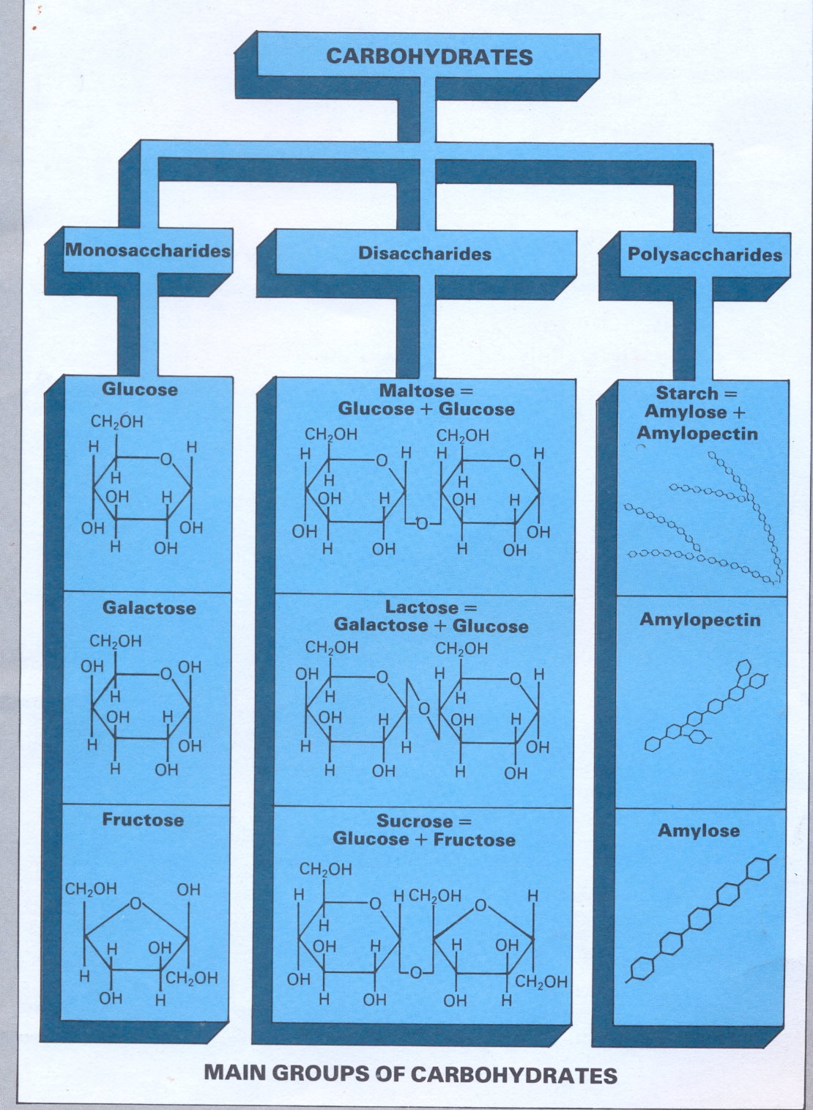

Slide 6
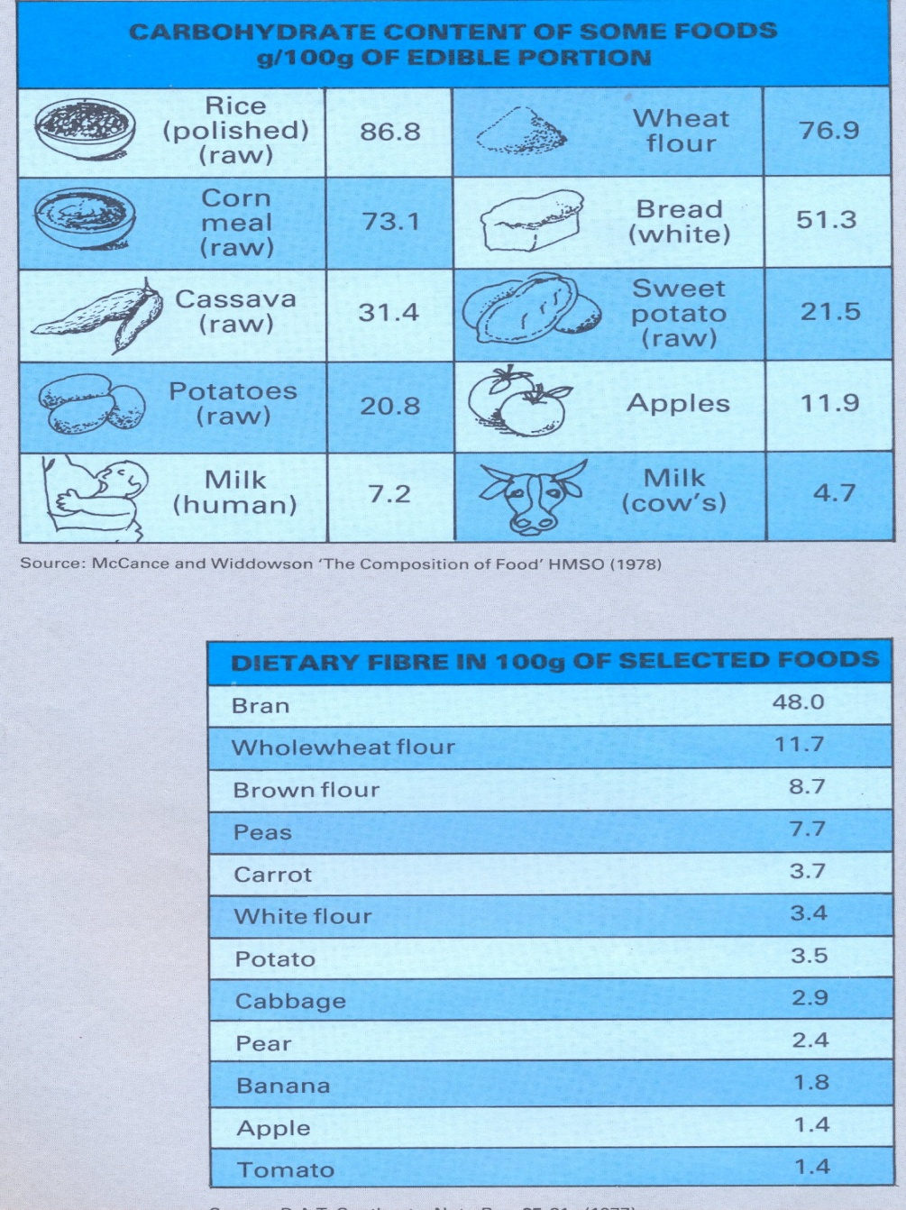
CARBOHYDRATES

Slide 7
PROTEIN
The specific characteristic of protein is that they contain nitrogen, which is almost constant: approx. 16g nitrogen per 100g protein.
Amino acids are the basic units of proteins. Proteins consist of amino acids linked by peptide bonds to form polypeptide chains. The formation of polypeptide chains give rise to different types of proteins.
There are 30 amino acids which occur in nature, (24 in the animal kingdom). In man, 9 amino acids are essential (must be supplied by the diet as the body cannot synthesise them)

Slide 8
AMINO ACIDS
Amino Acid
Non essential
Amino Acids
ASPARTIC ACID
GLUTAMIC ACID
ALANINE
ARGININE
CYSTINE
GLYCINE
HYDROXYPROLINE
PROLINE
SERINE
TYROSINE
Essential
Amino Acids
ISOLEUCINE
LEUCINE
LYSINE
METHIONINE
PHENYALANINE
THREONINE
TRYPTOPHAN
VALINE
HISTIDINE

Slide 9
SOURCES OF PROTEINS
Animal Proteins: meat, fish, eggs, milk, cheese
Plant Proteins: cereals (bread, rusks, pasta), pulses (lentils, chickpeas, beans)
Vegetables – these usually have a low protein content (1 – 2%)

Slide 10
ROLE OF PROTEINS
Proteins are used in building and renewing tissues. There is continual exchange between endogenous proteins (body constituents) and dietary proteins. Therefore protein intake must be frequent and adequate.
Proteins also have an energy – providing role (1g protein releases 4 kcal). This energy is only utilised if the carbohydrate and fat intake is inadequate or if the protein quality is poor.

Slide 11
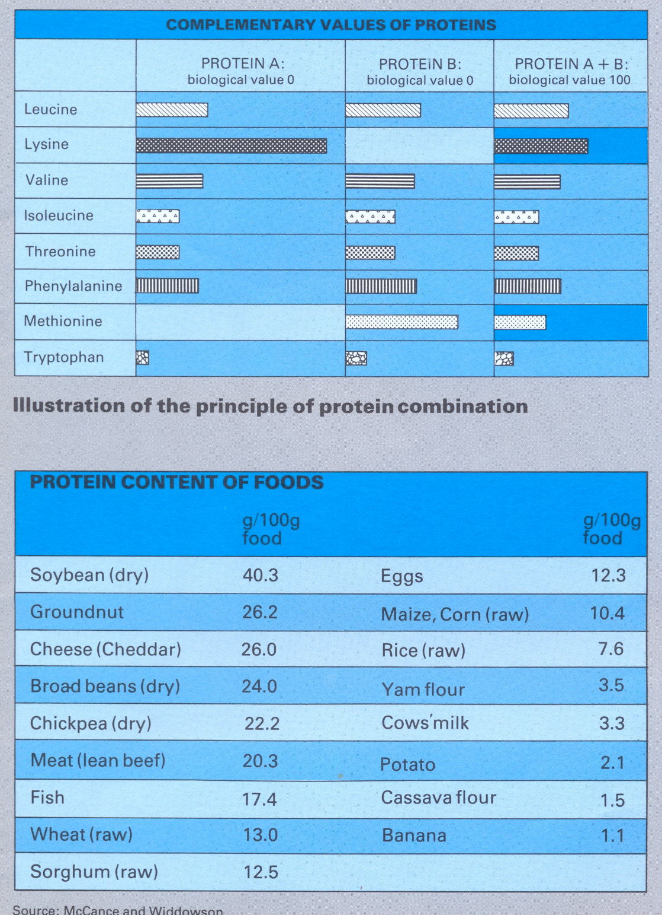

Slide 12
HOW TO IMPROVE THE QUALITY OF PROTEIN
Protein can be enriched with the limiting amino acid or acids. Though amino acids are rather expensive and not easily available.
The quality of proteins can be improved by combining different foods having complementary amino acid

Slide 13
LIPIDS
The lipids (fats) are widely distributed in nature and are characterised by their insolubility in water and high solubility in organic solvents.
They are a group of compounds including solids such as waxes, and liquids such as oils.
Phosphorus and also sulphur are constituents of some lipids.

Slide 14
FATTY ACIDS
The basic components of lipids are fatty acids. They form chains that vary in length from 4 to 26 carbon atoms.
The fatty acids are not linked in a long chain (as amino acids in proteins) but are bound to an alcohol, Glycerol, to form triglycerides

Slide 15
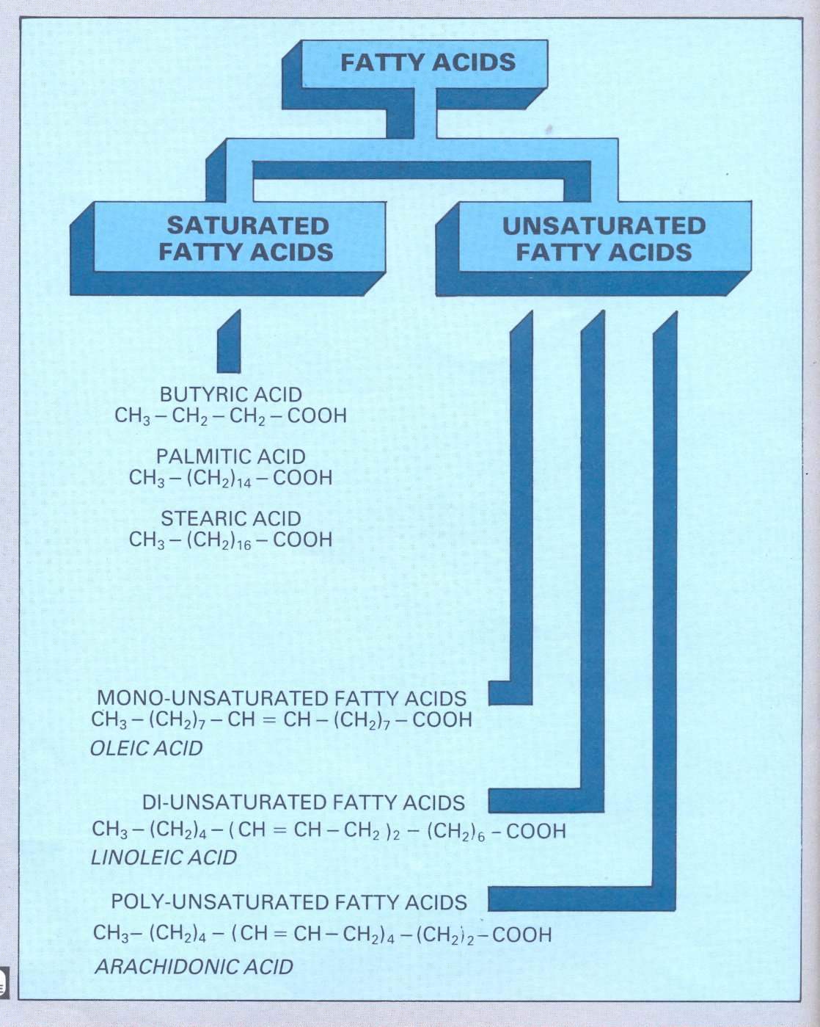

Slide 16
FATTY ACIDS
Saturated fatty acids – are characterised by single bonds between the carbon atoms e.g. butyric acid, palmitic acid and stearic acid.
Unsaturated fatty acids – are characterised by one or more double bonds. The double bonds can “open” and take up a single molecule, thus becoming saturated. Some unsaturated fatty acids contain only one double bond. These are called mono-unsaturated fatty acids e.g. Oleic acid.

Slide 17
WATER AND MINERAL SALTS
Quantitatively, water is the most important component of the human body. It represents, on average, 66% of body weight in adults and almost 75% in the newborn.
Water is essential for all life processes. The body can go without food for several weeks but it cannot do without water
Body water is divided into two compartments:
  Intracellular; approx. 50% of body weight and 2/3 of total body water
  Extracellular

Slide 18
Role and Sources of Water
Role
  It helps build and renew
  It acts as a solvent and carrier of nutrients and waste products in solution
  It is required for all biological reactions in the body
Sources
  The fluids we drink
  The food we eat
  As a by-products of fat, carbohydrates and proteins metabolism

Slide 19
MINERAL SALTS
Mineral refers to a group inorganic ions in their elemental form.
The essential minerals for nutrition, which must be supplied in the diet, may be classified as:
  Macroelements – essential for the normal development & functioning of the body at levels of 100mg or more per day.
  Microelements – essential to the body at level of 0.01mg to a few mg per day

Slide 20
CLASSIFICATION OF MINERALS
MINERALS
MACROELEMENT
Calcium
Phosphorus
Magnesium
Sodium
Potassium
Chloride
MICROELEMENT
Iron Manganese
Iodine Molybdenum
Zinc Selenium
Copper Fluoride
Chromium

Slide 21
ROLE OF MINERALS
They form part of the tissues and skeleton
They are essential for growth
Some act as catalysts or carriers and regulates the metabolism of several enzymes
Minerals also maintain nerve and muscular excitability
They are important in maintaining the acid – base balance

Slide 22
VITAMINS
The vitamins are a group of chemically unrelated organic compounds and are divided into two groups according to their solubility:
  The fat soluble (i.e.liposoluble) vitamins: A, D, E & K.
  The water soluble (i.e. hydrosoluble) vitamins: B complex and vitamin C, folic acid, panthothenic acid and niacin

Slide 23
ROLE OF VITAMINS
They are important for the digestion and utilisation of the energy-producing elements (protein, fat and carbohydrates) and mineral present in diets
They are components or cofactors of the enzymes, which catalyse metabolic processes
Vitamins are important for growth maintenance and repair of body tissues
Vitamin deficiency results in serious and frequently fatal disorders e.g. scurvy, rickets, beri beri and pellagra.

Slide 24
DIGESTION
Food must undergo several changes before it can be utilised by the tissues. Essentially five steps are involved in the breakdown and metabolism of macronutrients (carbohydrates, proteins, lipids).
Ingestion: the initial process of eating the food.
Digestion: The breakdown and cleavage of the complex food into simpler constituents in the digestive tract.
Metabolism: The absorbed food is transported by the bloodstream to the various tissues for utilisation. There are two phases of metabolism:
  Anabolism: involves synthesis or building up of new cellular material for growth or for the replacement of worn out body substances (maintenance).
  Catabolism involves breakdown whereby substances are broken down to supply energy or other substances. The body is in a state of dynamic equilibrium.
Elimination of waste products: Waste products occur during the process of metabolism. These include carbon dioxide which is eliminated by pulmonary ventilation, and urea excreted by the kidneys in the urine.

Slide 25
Principles of Digestion
Digestion may be defined as the breakdown of complex food material into simpler and more soluble constituents The process of digestion takes place in the digestive tract.
Digestion is accomplished by mechanical and chemical means. Mechanically, food is first physically reduced to smaller particles by the action of chewing and mastication in the mouth. This facilitates the breakdown of food chemically and increases the surface area available for the action of enzymes. Enzymes catalyse only one or a few closely related substrates (lock and key model of enzyme). i.e. model of enzyme-substrate complex suggests that each enzyme, like a lock can accommodate a specific substance i.e. substrate (key) with the correct fit and complementary shape. All enzymes gave an optimum pH for their specific reaction.

Slide 26
Summary of the nature and sites of digestion
Site | Action | Digestive process
Mouth | Mechanical chemical | Mastication/chewing Salivary enzyme (amylase)
Stomach | Mechanical Chemical | Peristalsis action of acid (hydrochloric acid) Gastric enzymes (pepsin)
Intestine | Mechanical Chemical | Peristalsis Pancreatic enzymes Intestinal enzymes Bile acids/bile salts

Slide 27
Digestion of Carbohydrate, Proteins, & Lipids
Nutrients | Action | Digestive process
Carbohydrate Starches are important source of carbohydrate in human nutrition | The Sites of carbohydrate digestion are the mouth and small intestine | The end product of starch digestion is glucose with enzymes amylase for digestion in salivary and maltase for pancreatic secretions
Proteins Digestion involves the breakdown of the peptide linkages joining the amino acids | The major sites for protein digestion are the stomach and small intestine | The enzymes involved in protein digestion are pepsin, trypsin, chymotrypsin, carboxypeptidase, aminopeptidase
Lipids Triglycerides are an important source of lipids in human nutrition | The major site for lipid digestion is the small intestine | Bile salts emulsify the lipids and are important in lipid digestion The end products of lipid digestion are fatty acids glycerol and monoglycerides The key enzyme involved in lipid digestion is pancreatic lipase

Slide 28
ABSORPTION
After the digestion of food is complete the nutrients are ready for absorption, the end products of digestion are:
  Monosaccharides (from carbohydrate, starch and disaccharides)
  Monoglycerides, fatty acids, glycerol (from lipids)
  Dipeptides and amino acids (from proteins)

Slide 29
Sites of absorption of food
Materials absorbed | Sites of absorption
Amino acids, dipeptides | Small intestine
Sugars | Small intestine
Glycerol, glycerides, fatty acids | Small intestine
Vitamins | Stomach and small intestine
Inorganic acids | Stomach and small intestine
Water | Entire gastrointestinal tract, especially the large and small intestine

Slide 30
Mechanisms for absorption
Passive diffusion: water and small water soluble nutrients diffuse through the tiny pores of the mucosal membrane
Active transport: nutrients, e.g. monosaccharides, amino acids, move across the mucosal membrane against a concentration gradient. This process is energy requiring and involves specific carrier systems
Pinocytosis: this is a process during which the cell membrane forms a pocket and engulfs the molecule, incorporating it into the cell.

Slide 31
Absorption Metabolism of Carbohydrate, Proteins, & Lipids
Nutrients | Action
Carbohydrate | Glucose and monosaccharides enter the capillaries of the portal vein and are transported to the liver The liver act as a ‘buffer’ maintaining the blood glucose level When the blood glucose level is low, glycogen is broken down to glucose by the liver Glucose can also be produced from proteins and glycerol (from fats). This process is called gluconeogenesis Glucose serves as a major source of energy for the cells of the body
Proteins | Amino acids enter the capillaries of the portal vein and are transported to the liver. The liver dictates the metabolic fate of these amino acids Some amino acids are used to synthesise plasma protein, while others enter the circulation as free amino acids The various cells in the body use the amino acids to synthesise a variety of enzymes and chemical substances All through life the proteins in the body are in a process of breakdown (catabolism) and resynthesis (anabolism). This process is called protein turnover.
Lipids | The absorbed fat is transported via either the portal vein or the lymphatic system. The liver and adipose tissue are in close interaction. With excess energy intake triglycerides are synthesised (lipogenesis) and stored in the adipose tissue; when there is a demand for energy, lipolysis occurs.

